Slide 1
Informal exclusions and access to justice
Expanding access to advice and representation for families facing exclusion

Slide 2
Advice and support for exclusions
There is no legal aid, meaning support is either provided on a private-paying basis or pro-bono.
There are a handful of pro-bono providers of support in London:
Just for Kids Law
The School Exclusions Project
There are almost no pro-bono providers outside of London, meaning families have nowhere to turn.

Slide 3
Public awareness of legal issues
Many families are not aware that typical informal exclusions constitute a legal issue.
The scale of the problem is unknown.
However, Just for Kids Law routinely come across instances of informal exclusion.
Families often refer themselves for help over a different issue, and an informal exclusion becomes apparent through examination of the matter.

Slide 4
Challenging an unlawful school exclusion
Avenues of challenge are limited.
For cases of discrimination the County Court and First Tier Tribunal are available.
Cases of discrimination other than disability lose out because the County Court is less accessible.
School complaints are an option but are slow, and not fully independent.
Public law claims are the most difficult, but potentially most expedient forms of resolution.

Slide 5
Advice Clinics
Through Just for Kids Law’s partnership with Fieldfisher Solicitors we have expanded our own provision of legal work to Manchester and Birmingham.
The Fieldfisher clinics have taken on young people who have been informally excluded, including one who was told not to return to class after her mock exam results were not sufficient.
These cases have been successful for the young people we work with, and present opportunity for wider strategic change.

Slide 6
The School Exclusions Hub
The School Exclusions Hub is Just for Kids Law’s new toolkit to help advice organisations provide advice and representation.
The Hub launched in November 2019.
The Hub contains information, guides and downloadable resources including precedent documents for every stage of a challenge.
It contains information on the process families can expect, and what exclusions would be considered informal or off-rolling.

Slide 7
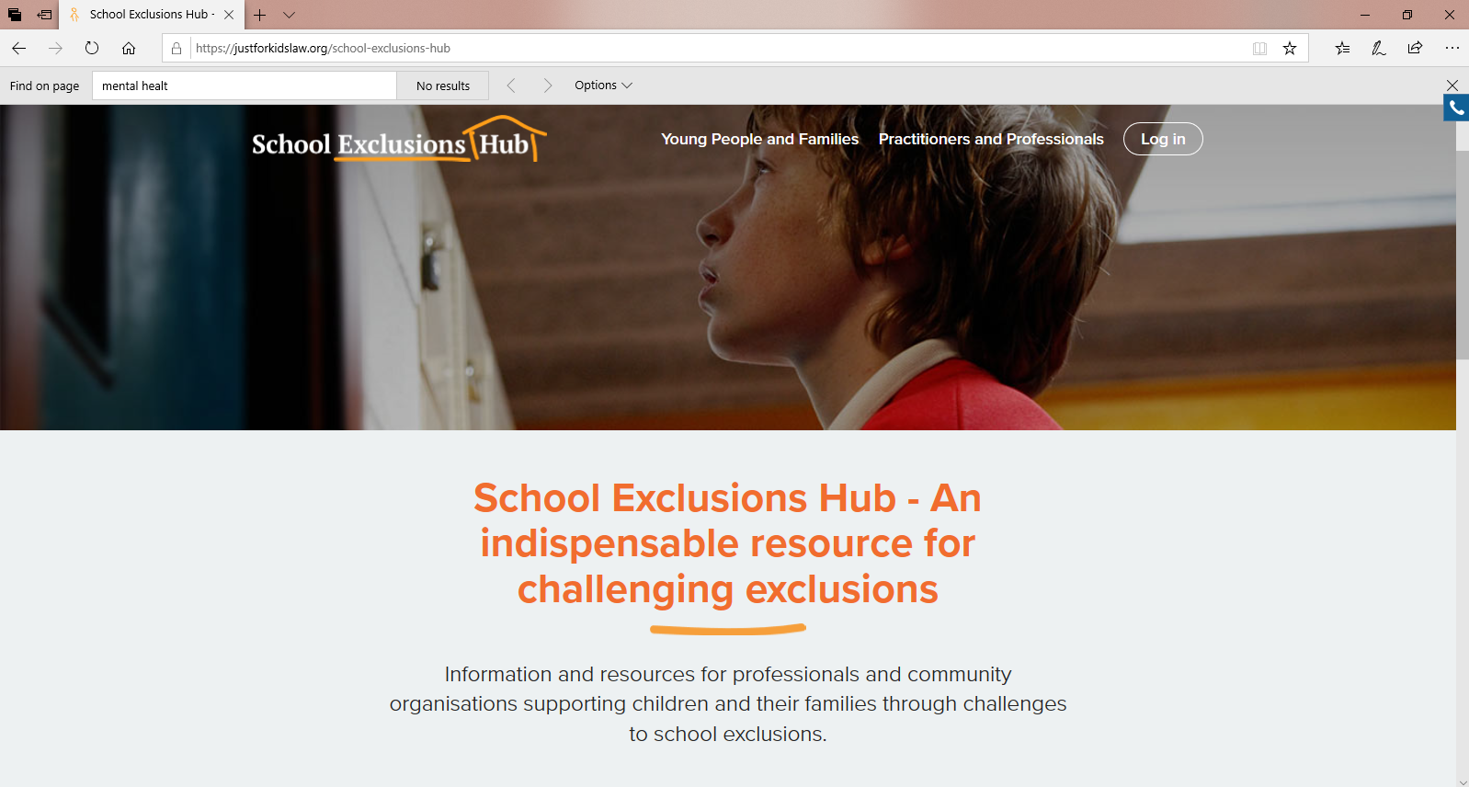
School Exclusions Hub

Slide 8
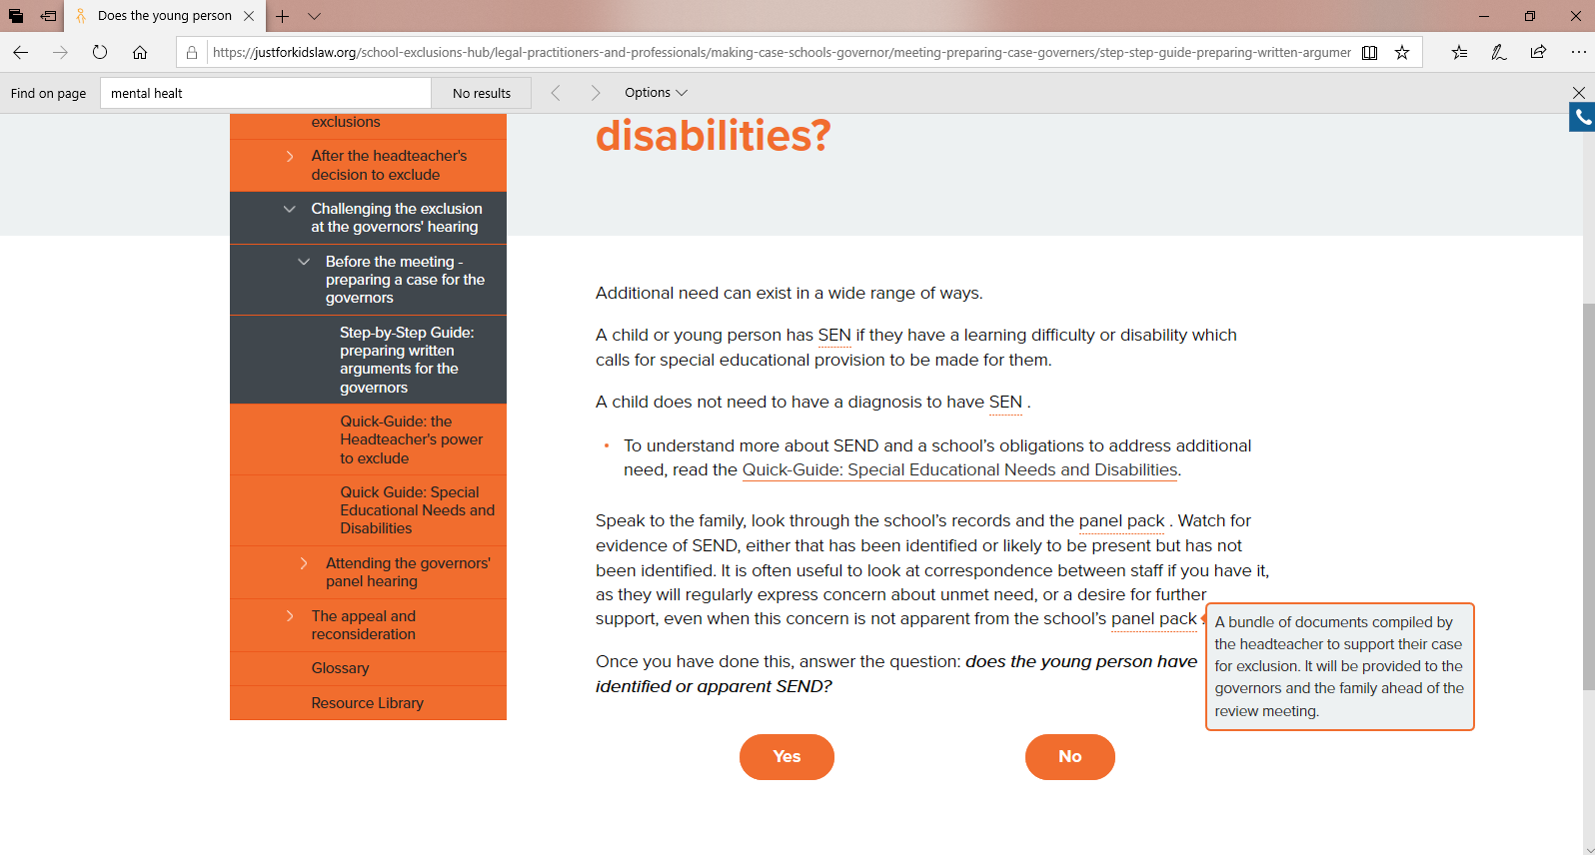
School Exclusions Hub

Slide 9
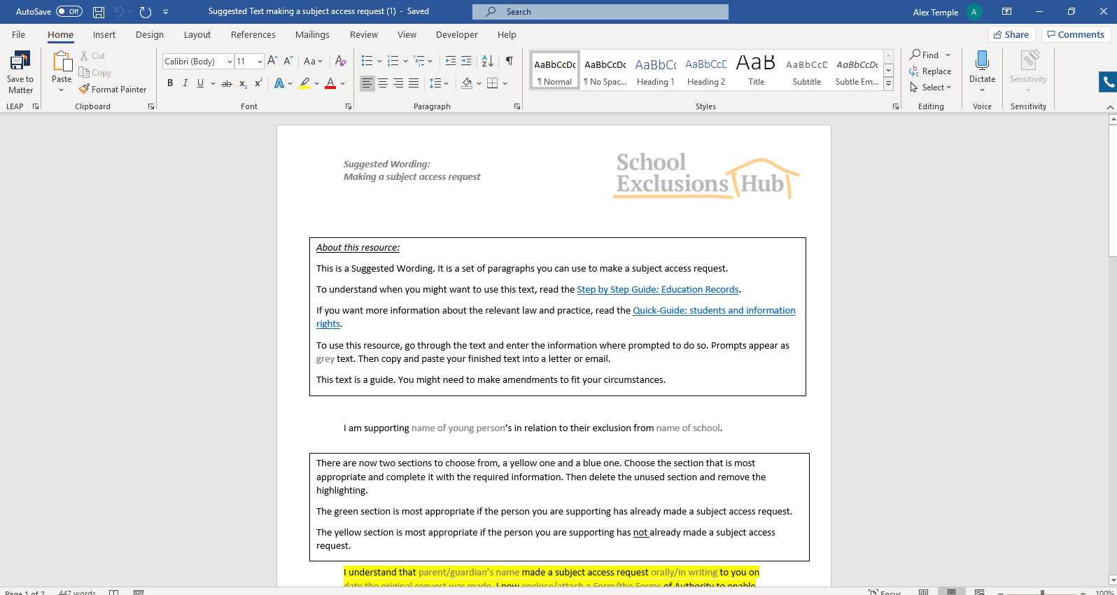
School Exclusions Hub

Slide 10

www.justforkidslaw.org/seh

Slide 11
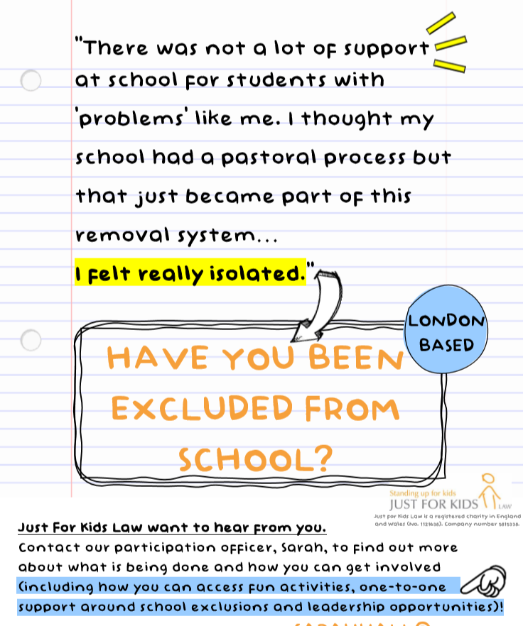
THE SCHOOL EXCLUSIONS PROJECT
What the Project offers:
Social activities chosen by you.
One-to-one meet ups.
Campaigning opportunities.
Work with media (Documentary producing, journalism, public speaking etc.).
Leadership Opportunities.
A chance to change the Law that affects you.
Group workshops.
Work with Government, Charities and United Nations.
“[School Exclusions Project] has been like a friend to me through a really isolating time.”

Slide 12

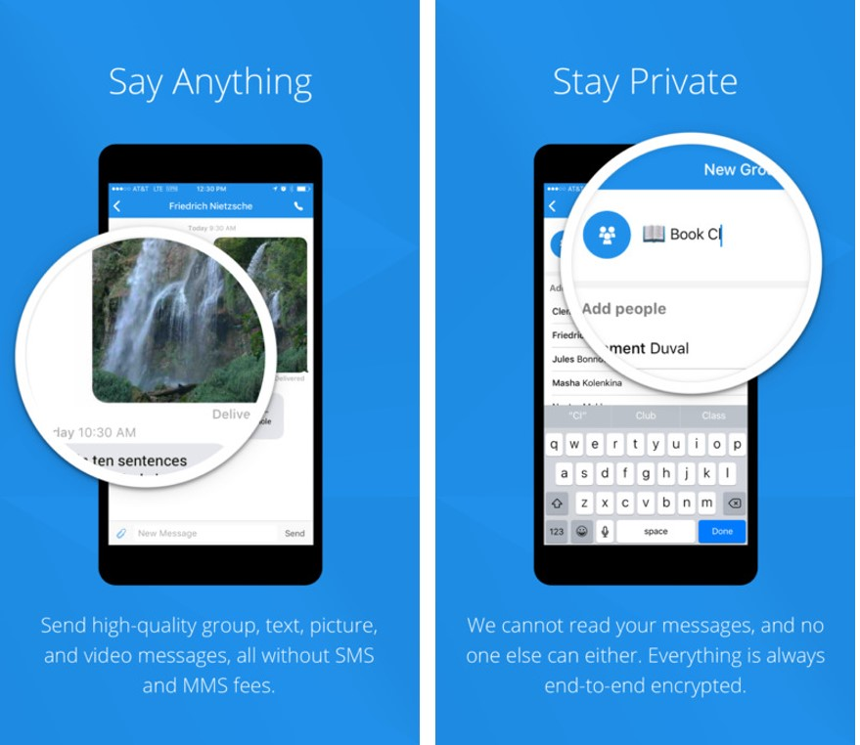
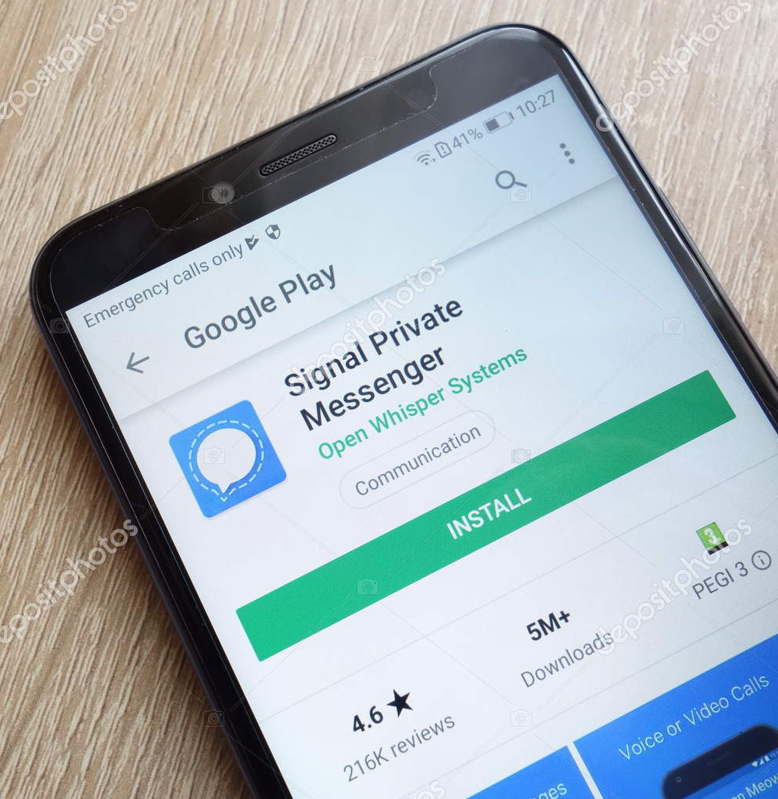
YOUTH VOICE DIGITAL PROGRAM
An easy to use text messaging programme designed to give you the platform to share your thoughts on the things that matter most to you!
Have your say over law and policy that affects you, with complete control over where your thoughts go.
Opportunities available with the programme include group training with an experienced journalist, the chance to become a ‘young writer’ for the BBC and you may even get to host your own podcast episode!
It’s your time to be heard.
Simply download the signal app and text “signup” to +442033223827 to get started.

