Slide 1

Unexplained exits from schools: what do we know?
20th January 2020
1

Slide 2
Headline findings
61,000 children in the Y11 2017 cohort had an unexplained exit
That is one in ten, or three per class of 30 (on average)
Does not include: official exclusions or those that left for ‘family reasons’
Does include: moves to another school, to AP and exits from state schools sector
2

Slide 3
What did we count?
Pupils who moved school or left school between autumn year 7 and summer year 11, in cases that were not:
Middle school transitions
Official permanent exclusions
These were classified as unexplained exits if they were not cases of:
Change of home address (different LSOA)
Adoption or change of care legal status where address info missing
Moving to a special school
Children who first attended school after reception (adjusted for local migration)
Children living on the border of Wales or Scotland
Gypsy/Roma/Traveller family children who move often / en masse
Children of armed services families
3

Slide 4
What did we count?
Unexplained versus off-rolling:
Data don’t tell us the motivation for moves
Shades of grey: everything from manipulation of GCSE results through to carefully planned moves to increase support for children’s needs
What if many are schools simply following the system…?
At least as far back as the Steer Review in 2009 DfE has encouraged schools to use ‘managed moves’ to avoid exclusions
But only a small minority of unexplained exits follow a 6-week dual registration…
Is motivation a red herring?
What happens after a child has an unexplained exit?
Who do unexplained exits happen to?
Does it increase segregation of vulnerable children?
4

Slide 5
What happens after an unexplained exit?
We do not know what happened to 24,000 children from the 2017 cohort
52% of the 61,000 are not immediately enrolled in another school
4 in 10 have not returned to a state school by the end of Y11
Of those that move into alternative provision, only 1 in 10 are reintegrated to a mainstream school later
For those who do move straight to another school:
  1 in 4 move to a school rated lower by Ofsted than their original school
  1 in 6 move from a school that is good or better to a school that is less than good
5

Slide 6
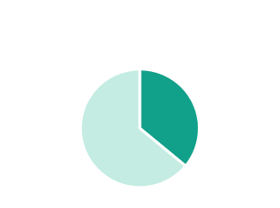
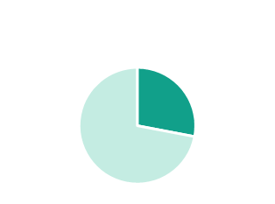
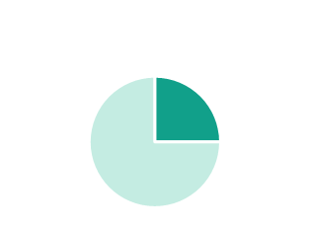
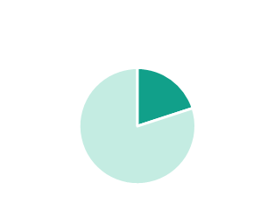
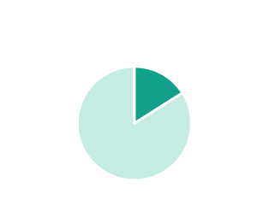
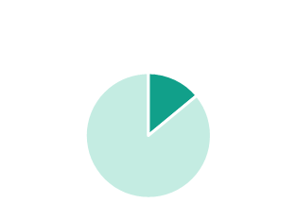
Which pupils are at greater risk?
> 1 in 3 kids who experienced permanent exclusion
Almost 1 in 3 of Looked After Children and of children with SEMH special needs
1 in 4 children with fixed period exclusions or significant absence
1 in 5 Children In Need of local authority social services
1 in 6 children with any type of SEND and of those who are ever eligible for FSM
1 in 7 children from Black ethnic groups and children with low prior attainment
6

Slide 7
Which ethnic groups are at greater risk?
7

Slide 8
Plotting Unexplained Exits and Exclusions
Large MATs and some London LAs stand out as above-average
8

Slide 9
Recommendations
High Needs funding needs to support greater early help and resources to support schools
Every head teacher needs high quality SEND training
Children at risk of exiting their school need independent representation
Behaviour guidance needs to recognise trauma, SEND, mental health and deprivation: it’s not clear enough what a reasonable adjustment is and these are not costed in properly
School accountability should recognise vulnerability and reward inclusion, health and child development
The government needs to get a stronger grip on pupil mobility and the interplay with various policies through better data and regulation
9

Slide 10
Next steps (2020-2021)
Understanding local protocols and practice around the mobility of vulnerable pupils
What do local fair access protocols look like?
What is the relationship between types of managed move / negotiated transfer in local areas and numbers of unexplained exits and official exclusions?
How do young people and their families experience a managed move?
Outcomes for children who experience managed moves
Do managed moves reduce the likelihood of a later permanent exclusion?
Are outcomes for pupils who experience managed moves better than for those who experience a permanent exclusion?
10
Notes:
Questioning some of the assumptions behind managed moves and the assertion that they are done to prevent PX, in the child’s best interest

Slide 11
We are listening! Send feedback to feedback@epi.org.uk
11

